Slide 1
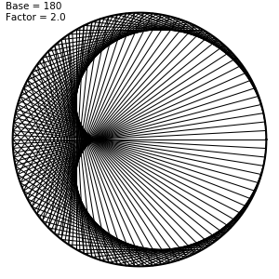
Let’s make an application
with Haskell

Slide 2
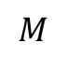
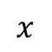
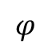
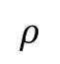
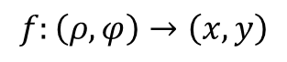

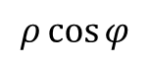
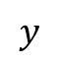
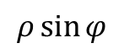
Polar coordinate system
$$y$$
$$f:\left(ρ,φ\right)→\left(x,y\right)$$
$$ρ\cos{φ}$$
$$M$$
.
$$ρ$$
$$ρ\sin{φ}$$
$$φ$$
$$0$$
$$x$$
toCartesian :: Point -> Point
toCartesian (ρ, φ) = (ρ * cos φ, ρ * sin φ)

Slide 3

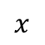

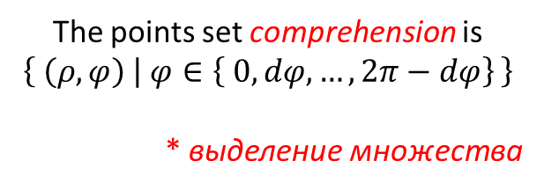
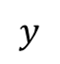
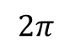
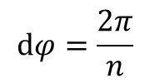
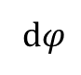


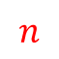
Build a circle
$$y$$
.
$$dφ=\frac{2π}{n}$$
.
$$2$$
.
The points set comprehension is
$$\left\{ \left(ρ,φ\right) | φ∈\left\{ 0, dφ,…,2π−dφ\right\} \right\}$$
* выделение множества
.
d$φ$
$$1$$
$$0$$
.
$$0$$
$$2π$$
$$x$$
$$n$$
.
.
.
createCircle :: Float -> Int -> [Point]
createCircle ρ n =
where
dφ = 2 * π / fromIntegral n
map toCartesian
[(ρ, φ) | φ <- [0, dφ .. 2 * π - dφ]]

Slide 4

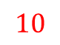


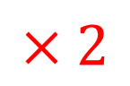








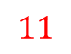
Draw the lines between the points
data Line = Between { start, end :: Point }
createLines :: Float -> [Point] -> [Line]
createLines factor points = map connect paths
where
$$…$$
$$×2$$
count = fromIntegral $ length points
$$2$$
$$3$$
.
.
starts = [0 .. count – 1]
$$11$$
$$1$$
.
$$4$$
.
ends = map (\start -> (start * factor) `mod'` count) starts
paths = zip starts ends -- [(start, end)]
connect = \(start, end) -> Between
$$10$$
$$0$$
.
.
$$5$$
{ start = points !! floor start
, end = points !! floor end
.
.
}
$$6$$
$$9$$
.
.
$$8$$
$$7$$
-- In our case:
starts = [0, 1, 2, 3, 4, 5, 6, 7, 8, 9]
ends = [0, 2, 4, 6, 8, 0, 2, 4, 6, 8]

Slide 5
Construct a model
data Model = Model
{ base :: Int
, radius
, factor
, delta :: Float
}
model :: Model
model = Model
{ base = 180
, radius = 350
, factor = 2
, delta = 0.01
}

Slide 6
Draw the model
class Renderable a where
render :: a -> Picture
instance Renderable Model where
render (Model base radius factor delta) =
Color black $ Pictures [ring, lines]
where
ring = Circle radius
lines = Pictures
. map render
. createLines factor
$ createCircle radius base
instance Renderable Line where
render (Between start end) = Line [start, end]

Slide 7
Animate the model
update :: ViewPort -> Float -> Model -> Model
update _ _ model = model { factor = factor model + delta model }

Slide 8
Write the main function
main :: IO ()
main = do
let
padding = 10
side = round (radius model) * 2 + padding
size = (side, side)
position <- centerScreen size
let
title = "Multiplication circle"
background = white
mode = InWindow title size position
fps = 30
simulate mode background fps model render update

Slide 9
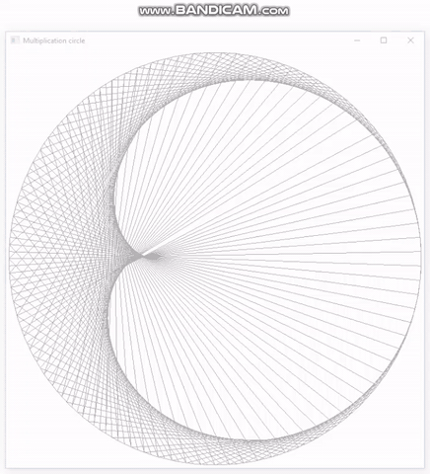
Lo and behold!

Slide 10
Thanks for attention!

